Slide 1
Highway Planning & Design Lecture - 5
Designed and presented
By
Asst. Prof. Dr. Raquim Nihad Zehawi

Slide 2
Sight Distance on Vertical Curves
• The minimum length of vertical curve is governed by sight-distance considerations.
• On vertical curves, sight distance (stopping sight distance) is measured from an assumed eye height
of 3.5 ft (1080 mm) and an object height of 2.0 ft (600 mm).
• Design values of crest vertical curves for passing sight distance differ from those for stopping sight
distance because of the different sight distance and object height criteria 1,080 mm [3.5 ft] height of
object.
• For crest vertical curves, the daylight sight line controls minimum length of vertical curves.
• For sag vertical curves, the sight distance is limited by the headlamp range during nighttime driving
conditions.

Slide 3
Length of Crest Vertical Curves Based on SSD
minimum stopping sight distance (SSD) is the only criterion used for design of a crest vertical curve
two possible scenarios that could control the design length:
(1) the SSD is greater than the length of the vertical curve
(2) the SSD is less than the length of the vertical curve.

Slide 4
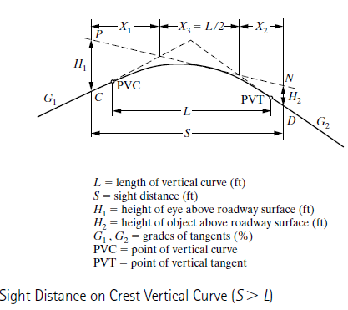
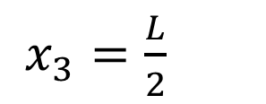
(1) the SSD is greater than the length of the vertical curve
$x_{3}=\frac{L}{2}$
From the properties of the parabola
The SSD S is $S=x_{1}+\frac{L}{2}+x_{2}$
$x_{1}$ and $x_{2}$ can be determined from grades G1 and G2 and their algebraic difference A
${in customary units H}_{1}$= 3.75 ft, and $H_{2}$= 0.5 ft

Slide 5
${in Metric units H}_{1}$= 1.08 m, and $H_{2}$= 0.6 m
These figures were adopted recently
L,S: in meters, A: in percent
$for passing sight distance H_{1}$= 1.08 m, and $H_{2}$= 1.08 m
L,S: in meters, A: in percent

Slide 6
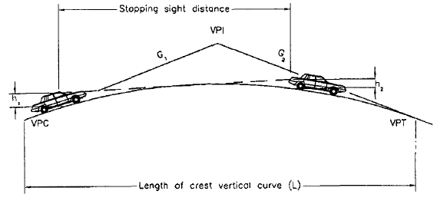
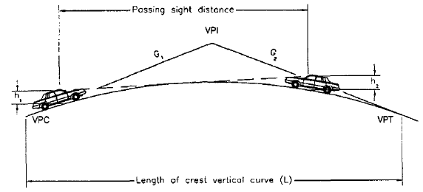
(2) the SSD is less than the length of the vertical curve.
${in Metric units H}_{1}$= 1.08 m, and $H_{2}$= 0.6 m
$$for passing sight distance$$
$H_{1}$= 1.08 m, and $H_{2}$= 1.08 m

Slide 7
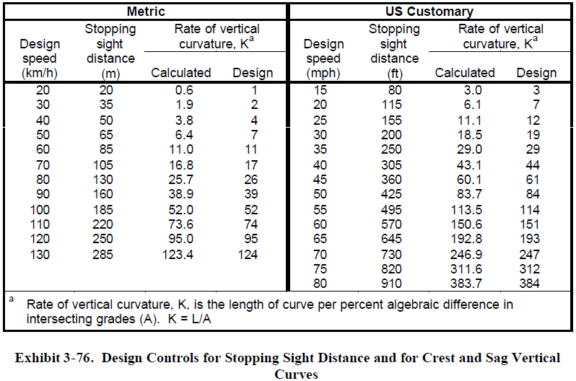
Crest Vertical Curve Design
The relation between K value and SSD

Slide 8
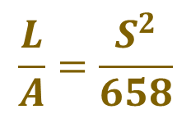
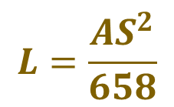
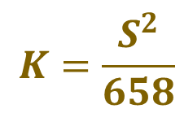
The SSD shown in Table depending on design speed
$$L=\frac{AS^{2}}{658}$$
$$\frac{L}{A}=\frac{S^{2}}{658}$$
$$K=\frac{S^{2}}{658}$$
When SSD < L
Example 3
The design speed of the highway is ranging from 100 - 120Km/h. The initial and final grades are G1= 2.5% & G2 = -1.5%
Calculate corresponding minimum length of the vertical curve that satisfies the minimum stopping sight distance
Solution:
$$L_{min}=K.A$$
K=$\left|2.5−−1.5\right|$= 4
From table for design speed of 100Km/h, K= 52
110 Km/h, K=74
120 Km/h, K= 95
for DS 100
$$L_{min}=52×4=208m$$
for DS 110
$$L_{min}=74×4=296m$$
for DS 120
$$L_{min}=95×4=380m$$
The values of K derived above when S is less than L also can be used without significant error where S is greater than L

Slide 9
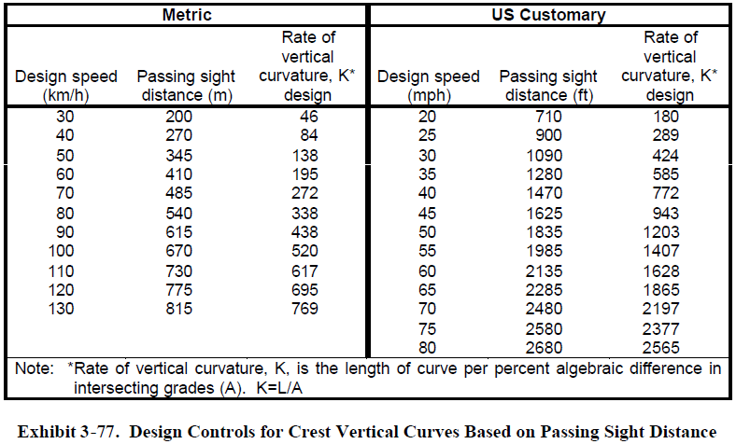
The relation between K value and Passing Sight Distance PSD

Slide 10
Example 4
The design speed of the highway is ranging from 100 - 120Km/h. The initial and final grades are G1= 2.5% & G2 = -1.5%
Calculate corresponding minimum length of the vertical curve that satisfies the minimum
passing sight distance
Solution:
$$L_{min}=K.A$$
K=$\left|2.5−−1.5\right|$= 4
From table for design speed of 100Km/h, K= 520
110 Km/h, K=617
120 Km/h, K= 695
for DS 100
$$L_{min}=520×4=2080m$$
for DS 110
$$L_{min}=617×4=2468m$$
for DS 120
$$L_{min}=695×4=2780m$$

Slide 11
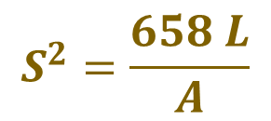
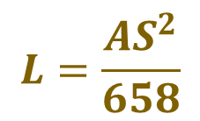
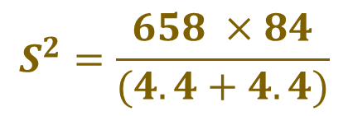
Maximum Safe Speed on a Crest Vertical Curve
Example 5
An existing vertical curve on a highway joins a +4.4% grade with a -4.4% grade. If the length of the curve is 275 ft = 84 m.
1- what is the maximum safe speed on this curve?
Assume (a = 11.2 ft /sec2 = 3.4 m/s2), perception-reaction time = 2.5 sec, and that S < L.
$$L=\frac{AS^{2}}{658}$$
Solution:
1- Determine the SSD using the length of the curve
$$S^{2}=\frac{658 L}{A}$$
$$S^{2}=\frac{658 ×84}{(4.4+4.4)}$$
$$S=79.25 m$$
Since SSD on the climbing from both directions
$$s=0.28.V.t+\frac{V^{2}}{254((\frac{a}{g})±G)}$$
$$79.25=0.28×2.5 t+\frac{V^{2}}{254((\frac{3.4}{9.81})+0.044)}$$
0.01$V^{2}+0.7V−79.25=0$
$$V=60.7 Km/h$$

Slide 12
Length of Sag Vertical Curves
The minimum length of a sag vertical curve is controlled by:
SSD provided by the headlight,
comfort while driving on the curve,
general appearance of the curve, and
adequate control of drainage at the low point of the curve.

